Slide 1
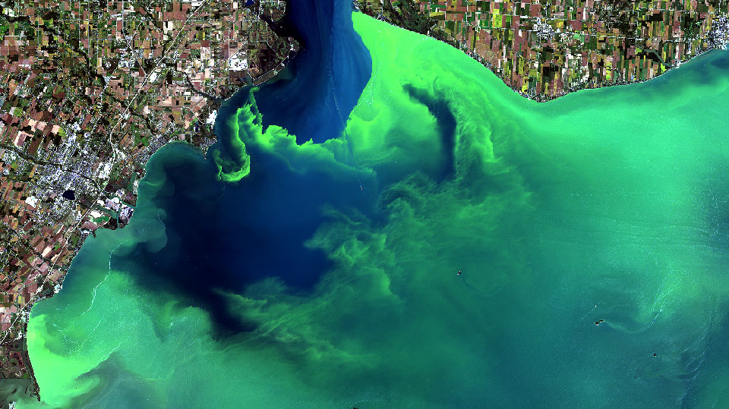

Remote sensing of water quality in Google Earth Engine Workshop
Victoria G. Stengel
vstengel@usgs.gov

Slide 2

// WORKSHOP GOALS
Introduction to remote sensing of water quality in the GEE environment.
Aquatic remote sensing science
Light-water interaction
Aquatic reflectance
Chlorophyll-a spectra
Hyperspectral reflectance compared to Landsat 8/9 and Sentinel-2 spectral resolution and indices
Code editor
Import multispectral imagery to qualitatively visualize a bloom event.
Import and manage image collections for cloud cover, time range, and study area.
Calculate and apply spectral water and Chlorophyll-a indices.
Produce time series chart.

Slide 3
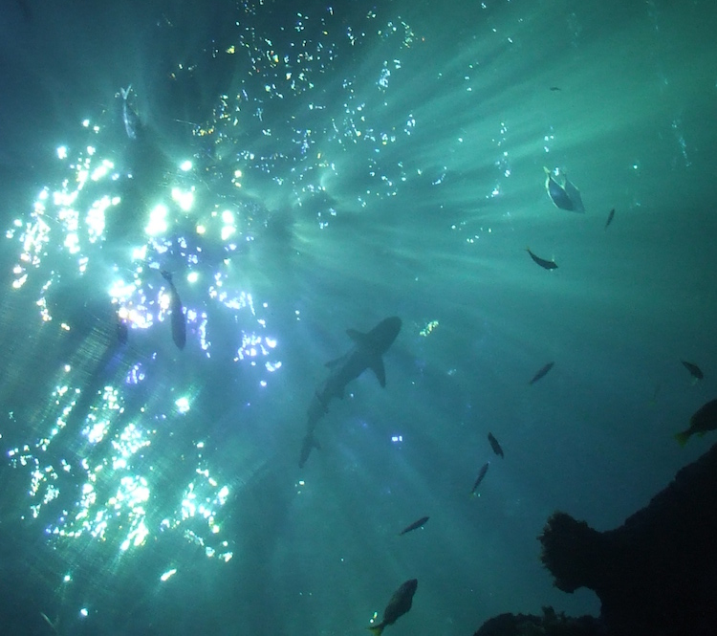
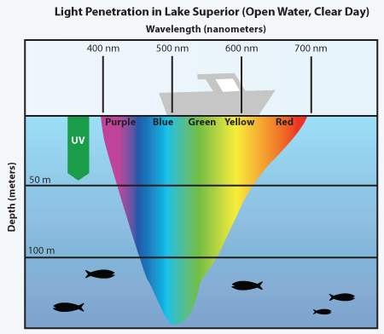
// AQUATIC LIGHT PENETRATION AND // ABSORPTION
“The measured signal is a function of all conditions and constituents of the atmosphere and the water. The retrieved TOA [(top of atmosphere)] signal contains approximately 90% atmospheric and 10% oceanic information.
The TOA measurement changes with the spectrum and the viewing geometry.
In the near infrared we expect a very low or no signal above (clear) water bodies due to the strong absorptive properties of waters beyond 750 nm but a high response in the blue visible range.
Water-color measurement instruments are designed to record data mostly within the optical spectrum in the visible and near infra-red from 380 to 800 nm ” - Mascarenhas, 2018
Depth penetration for the visible light spectrum (Image credit: Light in the Ocean)

Slide 4
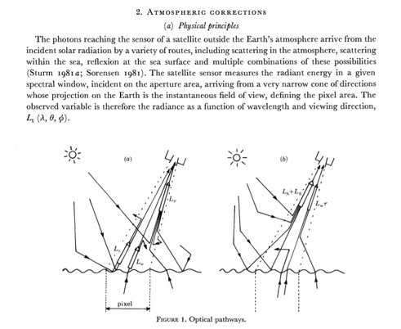
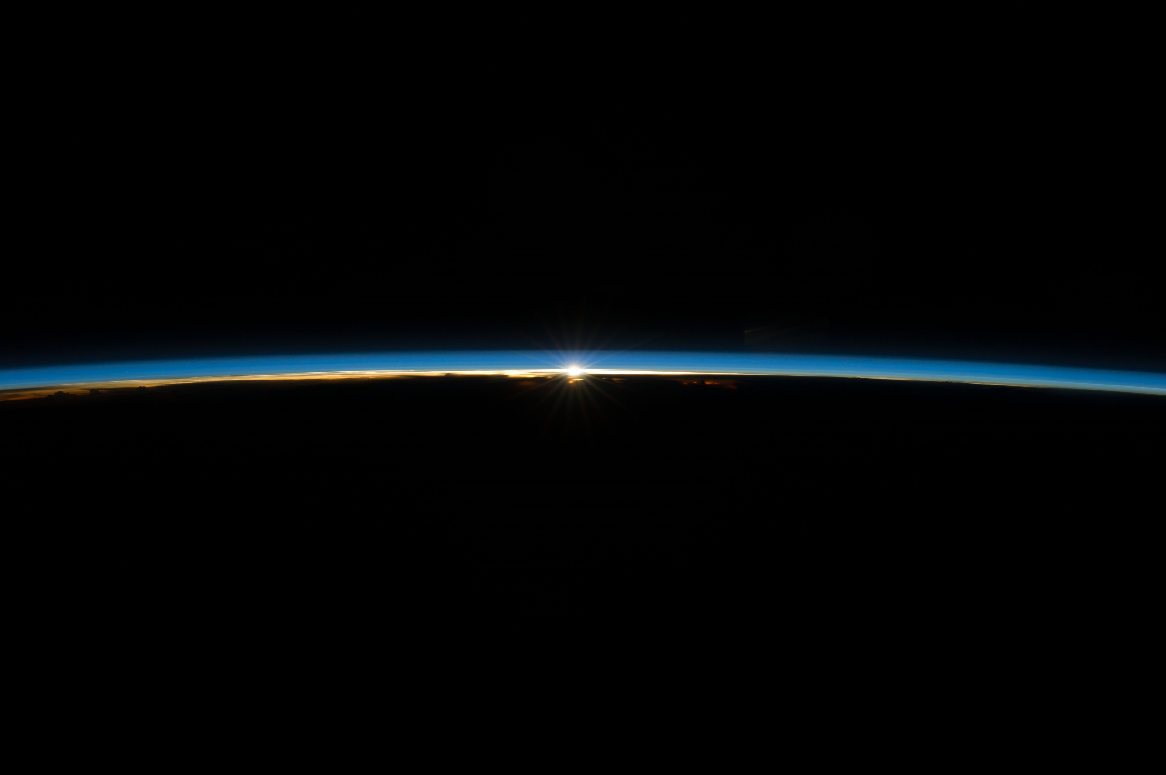
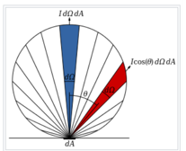
// AQUATIC REFLECTANCE
Radiative transfer theory describes the radiance propagation in an absorbing, emitting, and scattering 3D medium.​
Energy balance: Incident Energy = Absorbed Energy + Transmitted Energy + Reflected Energy (Mobley, 1999).
Lambertian surface/perfect reflector vs. surface roughness from wind causes increased light scattering, glint, and white caps, which affect the spectra..
Atmosphere correction, Robinson, 1983

Slide 5
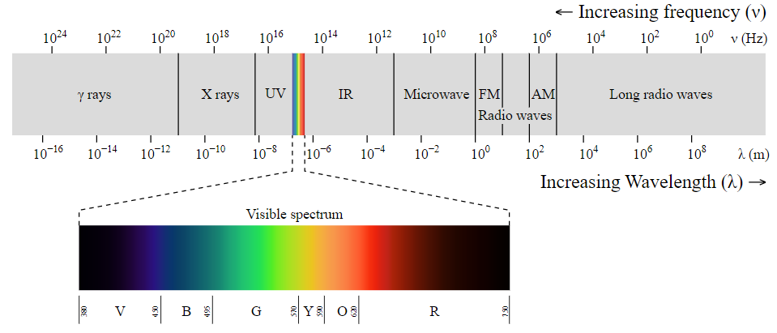
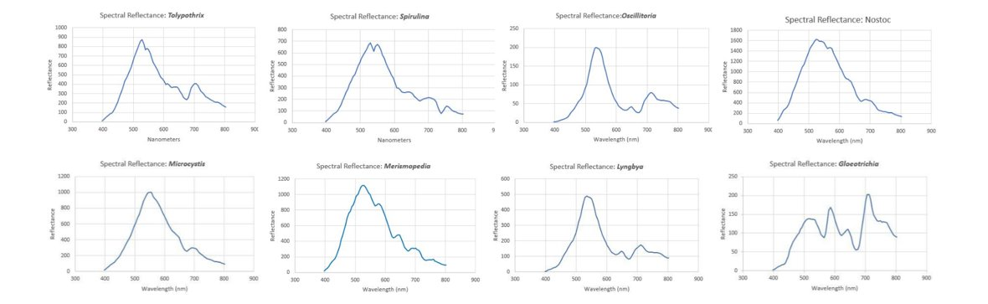
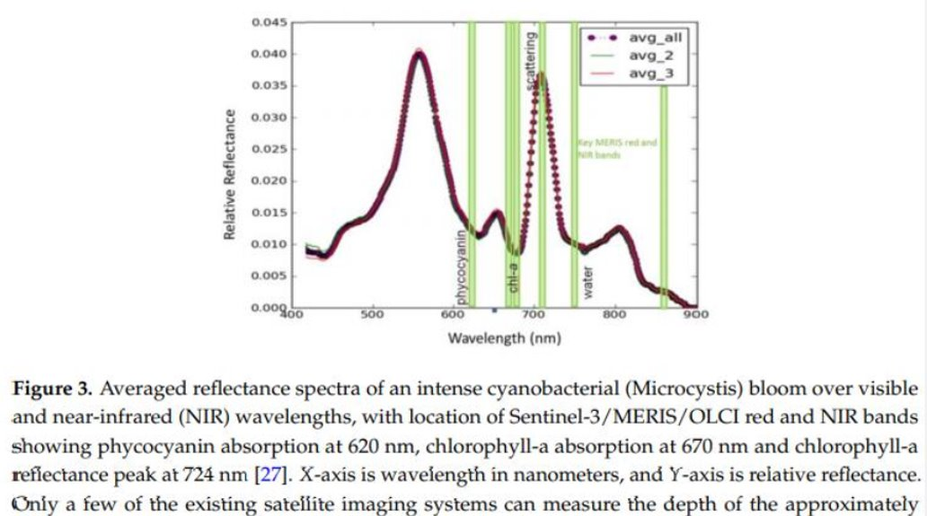
// AQUATIC CHLOROPHYLL-a SPECTRA
Electromagnetic spectrum, image credit: Wikipedia commons
Cyanobacteria lab spectra, Slonecker, et al., 2021
Cyanobacteria bloom spectra, Beck, et al., 2017

Slide 6
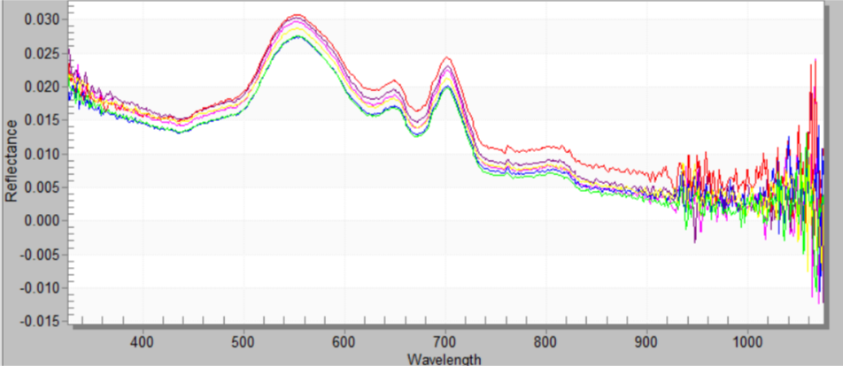
// HYPERSPECTRAL REFLECTANCE AND ABSORPTION OF CHL-A
// WITH LANDSAT 8/9 SPECTRAL RESOLUTION
// Normalized Difference Vegetation Index (NDVI) - ratio of red reflectance to NIR absorption (USGS EROS)
NDVI
x=(Rrs(λ1)-Rrs(λ2))/
(Rrs(λ1)+Rrs(λ2))
λ1 = 857 nm
λ2 = 644 nm
Phycocyanin absorption 620nm
Chl absorption 670nm
Chl reflectance 700nm
B1
B2
B3
B4
B5
Blue
Green
Red
NIR
NIR
NIR
Hyperspectral data acquired at Lake Lavon, Sept .14, 2020 (Sievers, et al., 2022)

Slide 7
// HYPERSPECTRAL REFLECTANCE AND ABSORPTION OF CHL-A
// WITH SENTINEL-2 SPECTRAL RESOLUTION
// Normalized Difference Chlorophyll-a Index (NDCI) - ratio of red reflectance to red edge (Mishra and Mishra, 2012; Beck, et al., 2016)
B4
B5
B6
B7
B8
B8a
NDCI
x=(Rrs(λ1)-Rrs(λ2))/
(Rrs(λ1)+Rrs(λ2))
λ1 = 665 nm
λ2 = 708 nm
Chl absorption 670nm
Chl reflectance 700nm
Phycocyanin absorption 620nm
B1
B2
B3
Blue
Green
Red
NIR
NIR
NIR
Hyperspectral data acquired at Lake Lavon, Sept .14, 2020 (Sievers, et al., 2022)

Slide 8
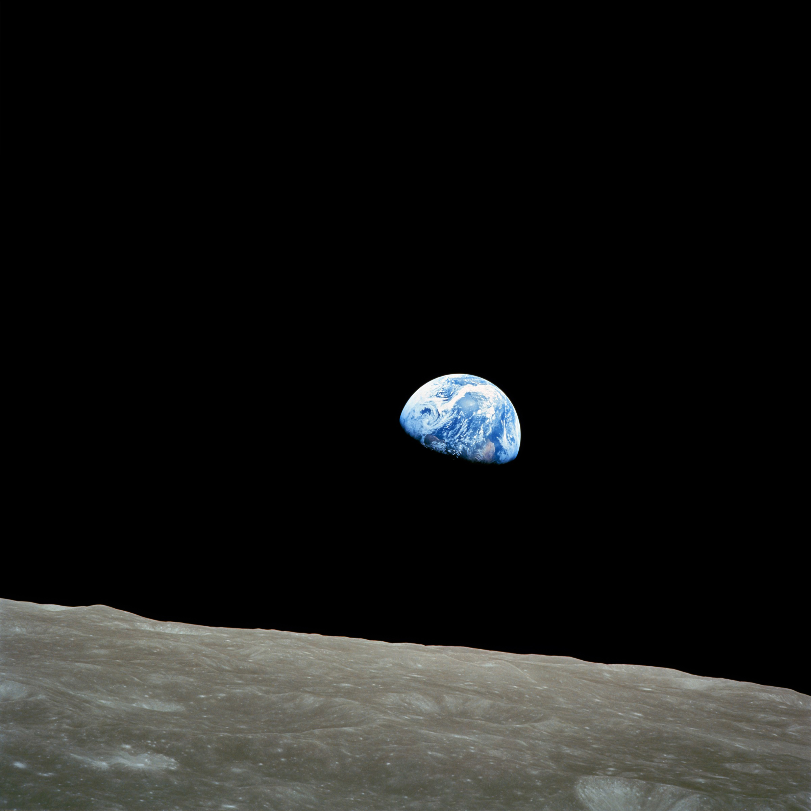
// Google Earth Engine
Planetary-scale geospatial analysis for everyone!
(Gorelick, 2017)
Accelerating scientific discovery
Facilitating a paradigm shift in the field of remote sensing and geospatial analysis from change detection to monitoring, enabling characterization of land surface dynamics and trends (Woodcock, 2020)
Introduction to GEE documentation: https://developers.google.com/earth-engine
GEE community produced textbook: www.eefa-book.org

Slide 9
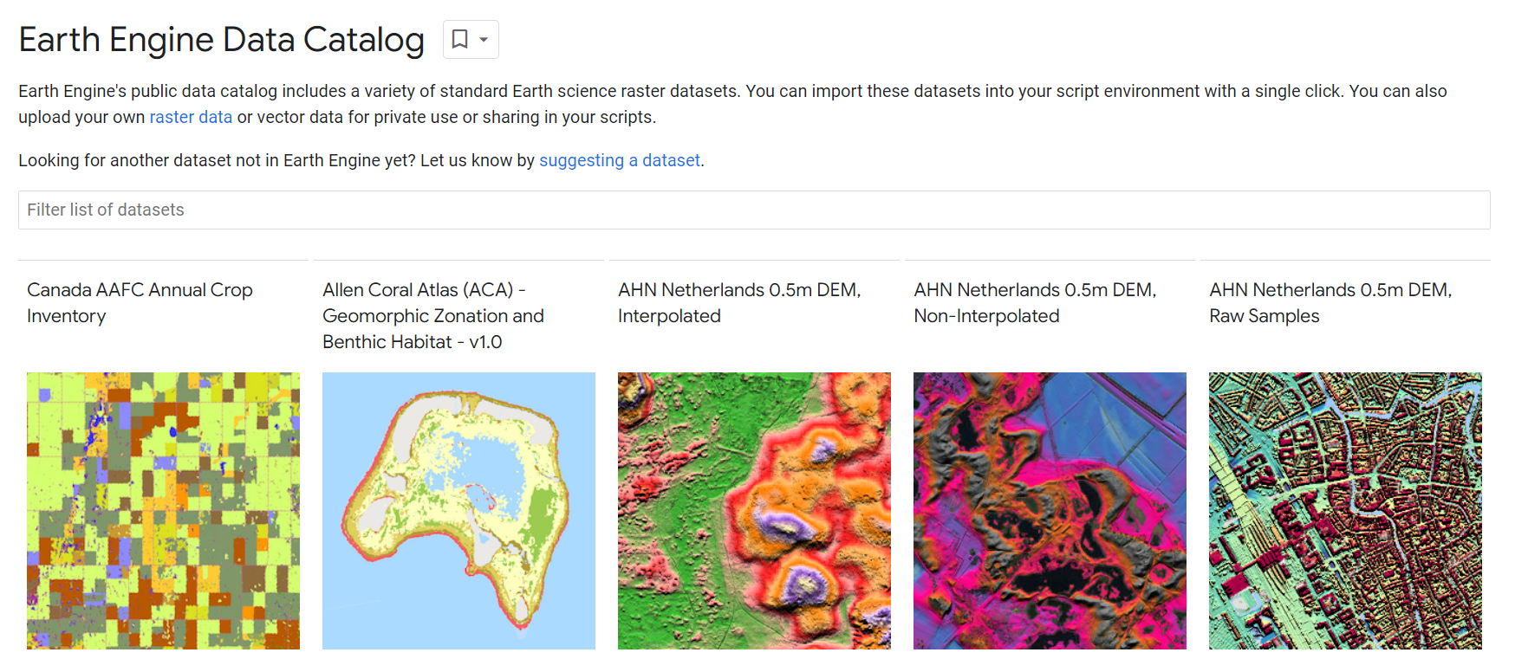
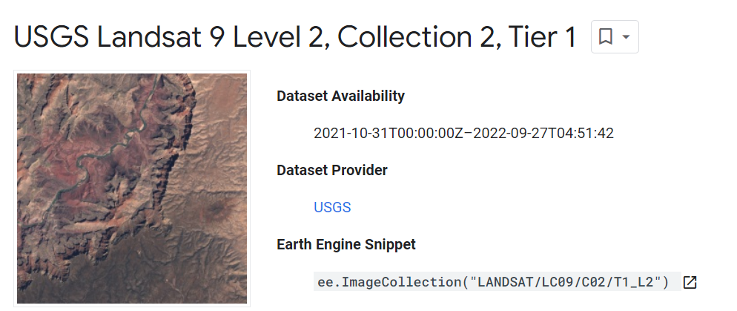
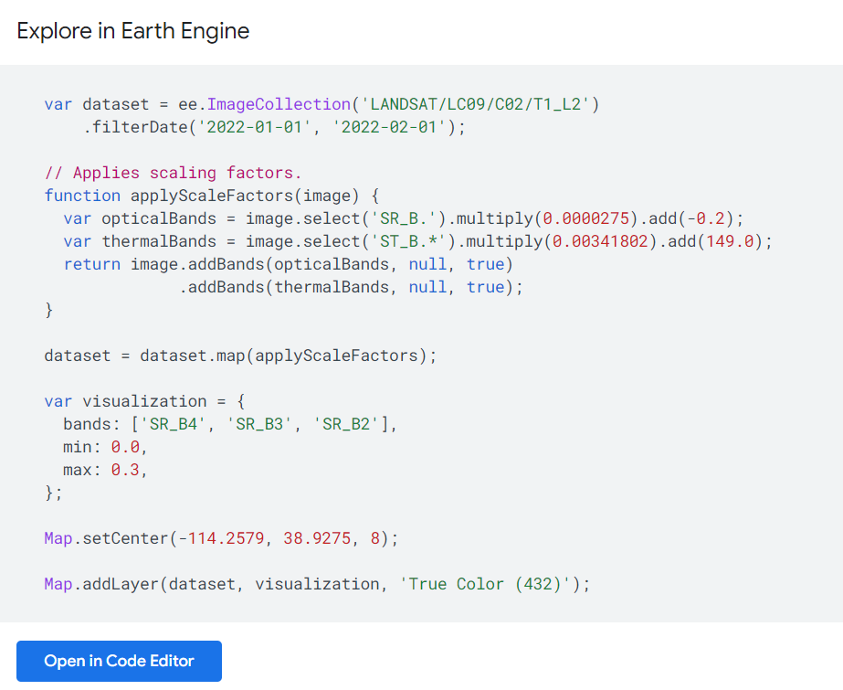
// GEE Data Catalog
// Facilitating the delivery of big data directly to the scientist
// Eliminating the need to download data saves an estimated 80% of labor time
// Majority of time spent on analysis
Cloud hosted global DATA CATALOG: https://developers.google.com/earth-engine/datasets/catalog
Data collections: multispectral, elevation, thematic classification, etc.
Including the Landsat and Sentinel-2 image collections
Atmosphere correction collections
Raw data -> top of atmosphere reflectance -> surface reflectance
Dataset description
Time-range availability
Bands /image metadata
Spatial, spectral, and temporal resolution
Earth Engine code snippet
Awesome GEE community catalog: https://samapriya.github.io/awesome-gee-community-datasets

Slide 10
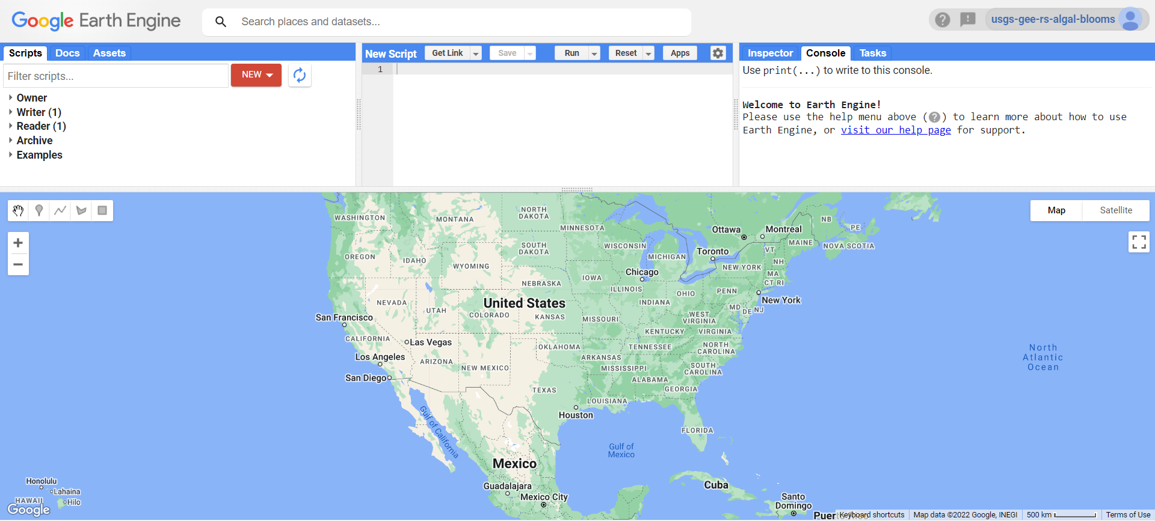
// GEE JavaScript API https://developers.google.com/earth-engine/tutorials/tutorials

Slide 11
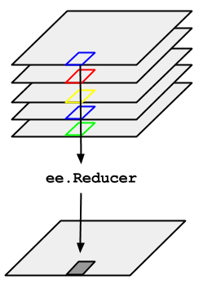
// VOCABULARY
Image vs. image Collection: https://developers.google.com/earth-engine/guides/ic_creating
Image visualization, composites, masking: https://developers.google.com/earth-engine/guides/image_visualization
Geometry: https://developers.google.com/earth-engine/guides/geometries
Feature vs. feature Collection: https://developers.google.com/earth-engine/guides/features
Reducer: https://developers.google.com/earth-engine/guides/reducers_intro
ee. reducer

Slide 12
// VISUALIZE AN ALGAL BLOOM EVENT
// 1. Find a bloom event
// 2. Import image
// 3. Visualize image
// Workshop GEE code: https://code.earthengine.google.com/ad7b00198716b258b3d5d4487bf34c3d

Slide 13
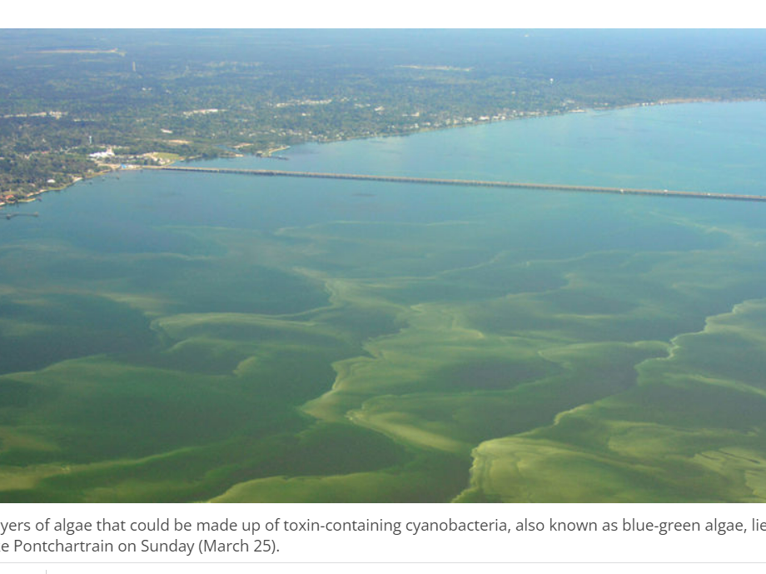
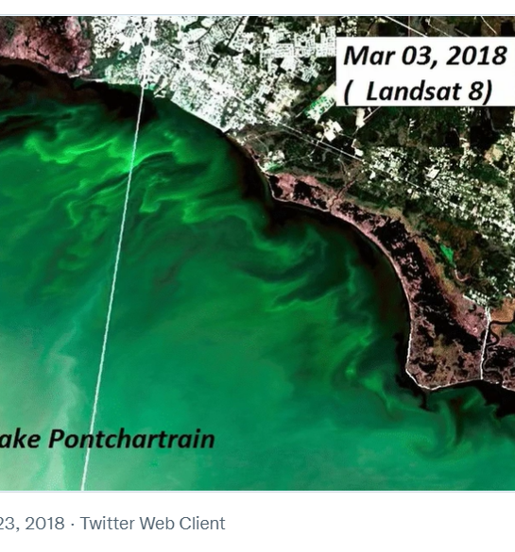
// FIND A BLOOM EVENT
March 2018
Lake Pontchartrain
New Orleans, Louisiana, USA

Slide 14
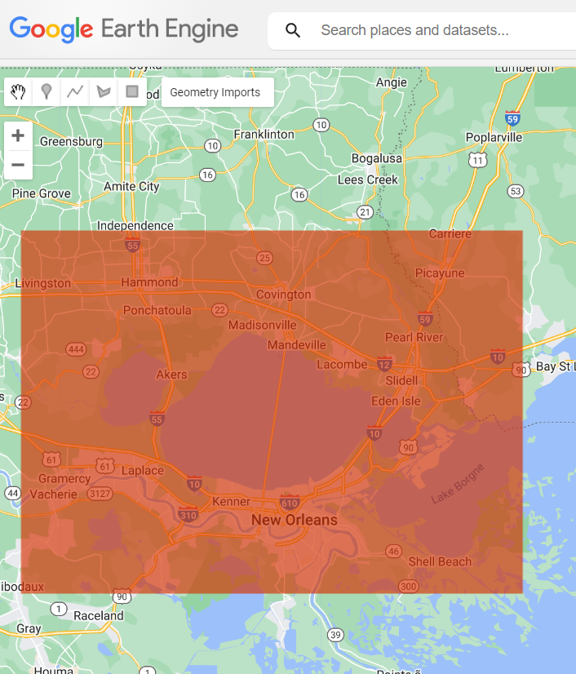
// DEFINE STUDY AREA
// Add layer to map, center object:
// 1. digitize the AOI polygon using the 'draw a shape' tool
// 2. import geometry, scale map
Map.centerObject(AOI, 9)
Code modified from: https://developers.google.com/earth-engine/apidocs/map-addlayer

Slide 15
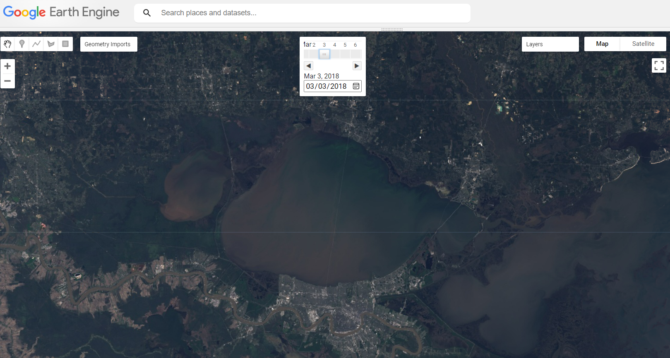
// BLOOM VISUALIZATION
// 1. Import a single Landsat image from March 3, 2018, Lake Pontchartrain, New Orleans, Louisiana, USA:
// 2. Visualize image, add to map
// Import Landsat 8 image (because Landsat 8 was active in 2018):
var Landsat8_20180303 = ee.Image('LANDSAT/LC08/C01/T1_SR/LC08_022039_20180303')
// Create true color (RBG432) visualization for Landsat 8 imagery
var L8_truecolorvis = {bands: ['B4','B3','B2'], min: 0, max: 3000, gamma: 1.4,};
// Add image as layer to map
Map.addLayer(Landsat8_20180303, L8_truecolorvis, 'True color Landsat 8’);
// Code modified from: https://developers.google.com/earth-engine/datasets/catalog/landsat-8

Slide 16
// CREATE WQ SPECTRAL INDEX // CREATE TIME SERIES CHART
// 1. Compute spectral indices: NDCI and NDWI.
// 2. Create Sentinel 2 cloud mask.
// 3. Create dynamic water mask.
// 4. Import Sentinel 2 image collection, apply filters, indices, and masks to image collection.
// 5. Visualize image, add to map.
// 6. Produce time series for zonal mean NDCI at point location.

Slide 17
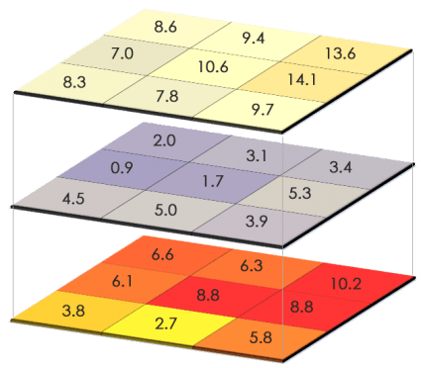
// COMPUTE SPECTRAL INDICES
var indices = function(image) {
// GEE Normalized Difference: https://developers.google.com/earth-engine/apidocs/ee-image-normalizeddifference
// Normalized Difference Water Index (NDWI): https://custom-scripts.sentinel-hub.com/custom-scripts/sentinel-2/ndwi/#
var NDWI = image.normalizedDifference(['B3','B8']).rename('ndwi');
// Normalized Difference Chlorophyll Index (NDCI): https://custom-scripts.sentinel-hub.com/custom-scripts/sentinel-2/ndci/#
// var NDCI = image.normalizedDifference(['B5','B4']).rename('ndci');
// Alternate way to compute index: code in equation
// var NDCI = img.expression(
// '(REONE-RED)/(REONE+RED)', {
// 'REONE': img.select('B5'),
// 'RED': img.select('B4'),
// }).rename('ndci');
// Add bands to stacked image collection
return image
.addBands(NDWI)
.addBands(NDCI); };
Raster math

Slide 18
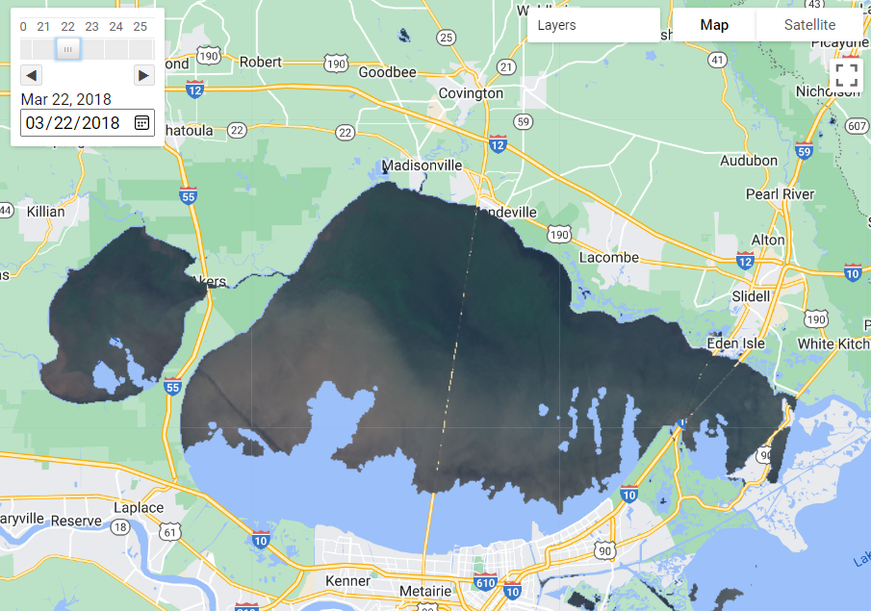
// CLOUD MASK USING THE SENTINEL 2 QA BAND
function maskS2clouds(image) {
var qa = image.select('QA60');
// Bits 10 and 11 are clouds and cirrus, respectively.
var cloudBitMask = 1 << 10;
var cirrusBitMask = 1 << 11;
// Both flags should be set to zero, indicating clear conditions.
var mask = qa.bitwiseAnd(cloudBitMask).eq(0)
.and(qa.bitwiseAnd(cirrusBitMask).eq(0));
return image.updateMask(mask).divide(10000); }
// Code source: https://developers.google.com/earth-engine/datasets/catalog/COPERNICUS_S2_SR
NDCI, Sentinel 2, March 22, 2018
Cloud masking

Slide 19
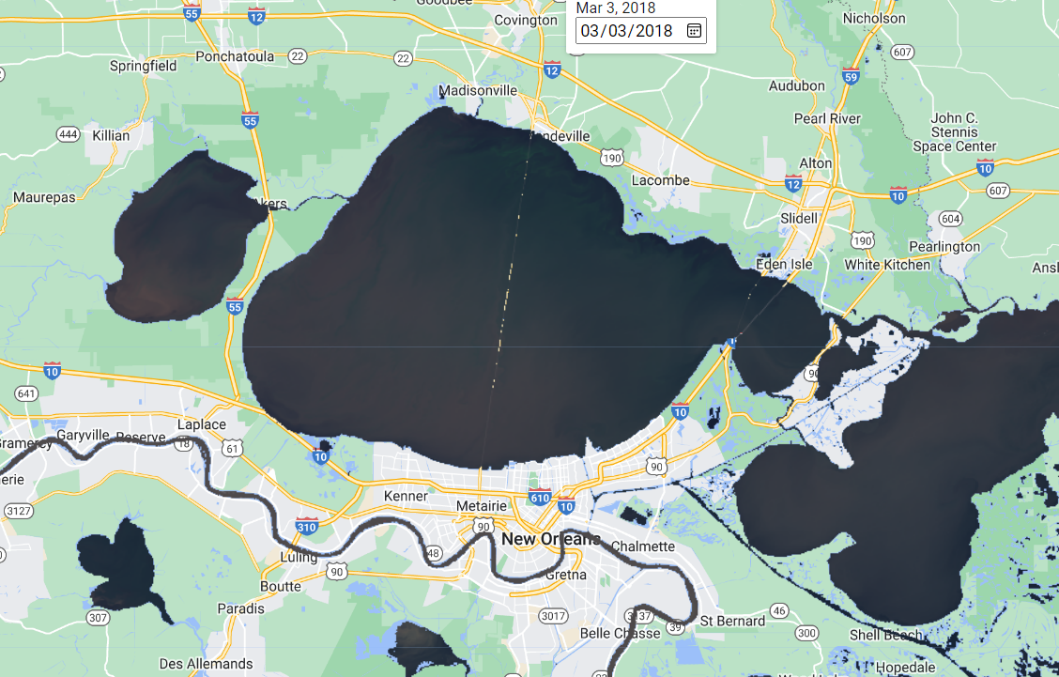
// CALCULATE DYNAMIC WATER MASK USING NDWI
NDVI, Landsat 8, March 3, 2018
// Water detection and masking function
function watermask(image) {
var ndwimask = image.select('ndwi').gte(0)
return image.updateMask(ndwimask); }

Slide 20
// IMPORT SENTINEL-2 IMAGE COLLECTION // APPLY FILTERS: DATE, CLOUD, AND AOI // APPLY INDICES AND MASKS
// Import Sentinel-2 Surface Reflectance image collection
var dataset = ee.ImageCollection('COPERNICUS/S2')
// Filter date range
.filterDate('2018-03-21', '2022-12-31')
// Filter cloud percentage in image metadata
.filter(ee.Filter.lt('CLOUDY_PIXEL_PERCENTAGE', 50))
// Filter bounds by study area
.filterBounds(AOI)
// Map cloud mask function
.map(maskS2clouds)
// Map indices function
.map(indices)
// Map water mask function
.map(watermask);
// Code modified from: https://developers.google.com/earth-engine/datasets/catalog/COPERNICUS_S2_SR

Slide 21
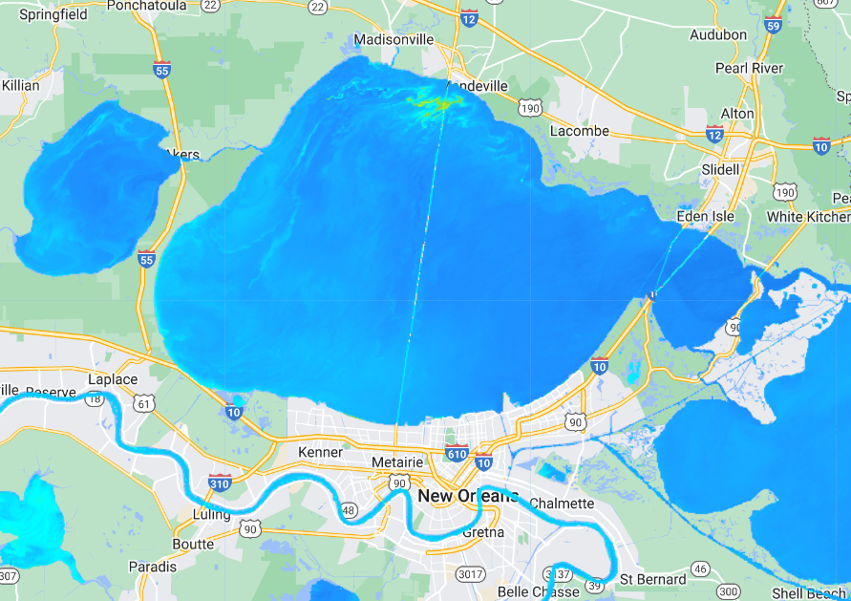
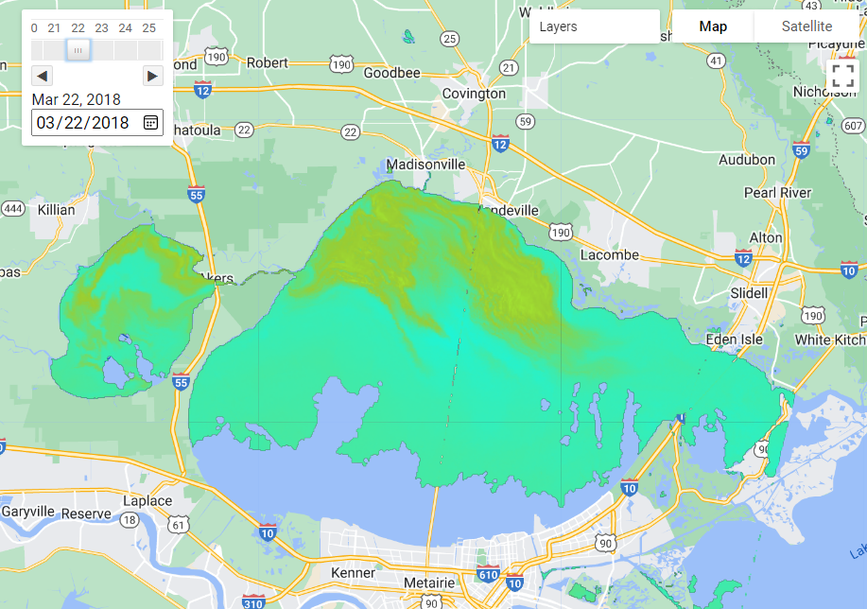
// SELECT AND PRINT FIRST IMAGE IN COLLECTION
// Extract and print first image in image collection
var First_S2 = dataset.limit(1, 'system:time_start').first();
print (First_S2, 'Latest true color mosaic')
// Visualize image, with cloud and water masking applied
var S2_CHLvis = {bands:['ndci'], min:-1, max:1, palette:['darkblue', ‘dodgerblue', 'cyan',’yellowgreen',’greenyellow', 'orange']};
// Add to map
Map.addLayer(First_S2, S2_CHLvis, 'S2 NDCI');
NDVI, Landsat 8, March 3, 2018
NDCI, Sentinel 2, March 22, 2018
Notes:
//// Note: If you would like to review the original image in this image collection sans masking, etc.
//// Import single Sentinel 2 image (https://developers.google.com/earth-engine/datasets/catalog/COPERNICUS_S2)
//var S2_20180322 = ee.Image('COPERNICUS/S2/20180322T163939_20180322T164513_T15RYP')
//// Visualize image, add to map
// Map.addLayer(S2_20180322, {bands: ['B8', 'B4', 'B3'], max: 4000}, 'S2')

Slide 22
// CREATE NDCI TIME SERIES CHART
// Create and place a point, name it ‘point’
// Create time series chart with reducer to extract mean chlorophyll for the 500m zone around point feature
var NDCIChart = ui.Chart.image.series(dataset.select('ndci'), point, ee.Reducer.mean(), 500, 'system:index');
// Chart parameters
NDCIChart.setOptions({
title: 'Time series for S2 collection',
vAxis: {title: 'Normalized Difference Chlorophyll Index (NDCI) value'},
hAxis: {title: 'Date', format: 'MM-yy', gridlines: {count: 7}},
series: { 0: { color: 'black', lineWidth: 0, pointsVisible: true, pointSize: 2, } },
legend: {position: 'left'}, });
// Print chart
print (NDCIChart);
//Code modified from: https://developers.google.com/earth-engine/apidocs/ui-chart-image-series

Slide 23
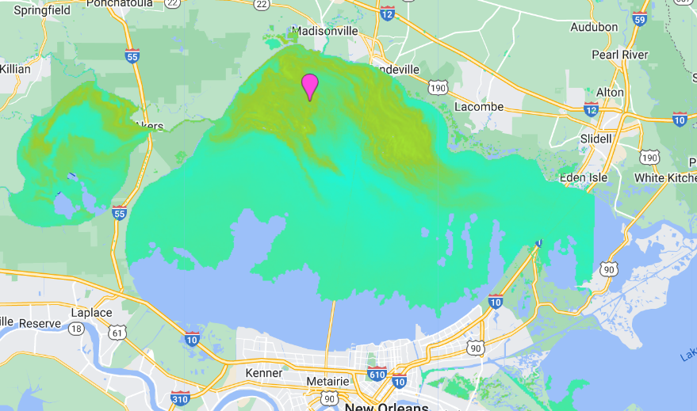
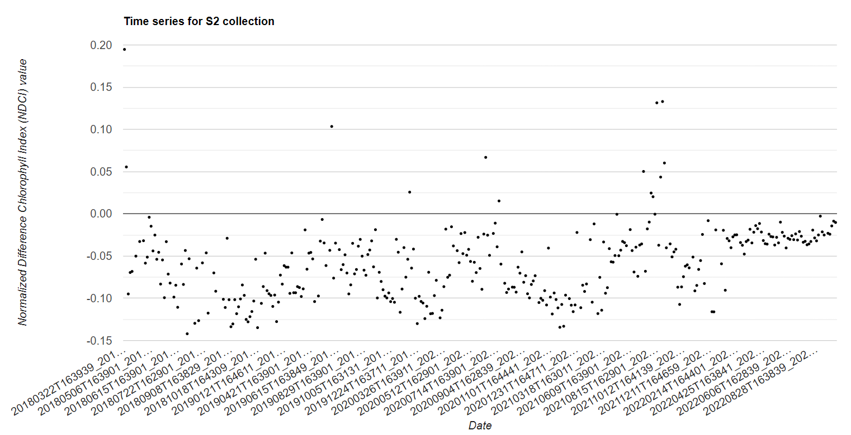
// NDCI TIME SERIES CHART
NDCI, Sentinel 2, March 22, 2018

Slide 24
Victoria G. Stengel
vstengel@usgs.gov

Slide 25
// REFERENCES
Beck, R., Xu, M., Zhan, S., Liu, H., Johansen, R., Tong, S., Yang, B., et al. 2017. “Comparison of Satellite Reflectance Algorithms for Estimating Phycocyanin Values and Cyanobacterial Total Biovolume in a Temperate Reservoir Using Coincident Hyperspectral Aircraft Imagery and Dense Coincident Surface Observations.” Remote Sensing 9 (6): 538. https://doi.org/10.3390/rs9060538 .
Beck, R., Zhan, S., Liu, H., Tong, S., Yang, B., Xu, M., Ye, Z., et al. 2016. “Comparison of Satellite Reflectance Algorithms for Estimating Chlorophyll-a in a Temperate Reservoir Using Coincident Hyperspectral Aircraft Imagery and Dense Coincident Surface Observations.” Remote Sensing of Environment 178 (June): 15–30. https://doi.org/10.1016/j.rse.2016.03.002 .
Gorelick, N., Hancher, M., Dixon, M., Ilyushchenko, S., Thau, D., and Moore, R. 2017. “Google Earth Engine: Planetary-Scale Geospatial Analysis for Everyone.” Remote Sensing of Environment 202 (December): 18–27. https://doi.org/10.1016/j.rse.2017.06.031 .
Mascarenhas, V, and Keck, T. 2018. “Marine Optics and Ocean Color Remote Sensing.” In YOUMARES 8 – Oceans Across Boundaries: Learning from Each Other, edited by Simon Jungblut, Viola Liebich, and Maya Bode, 41–54. Cham: Springer International Publishing. https://doi.org/10.1007/978-3-319-93284-2_4 .
Mishra, S., and Mishra, D. R. 2012. “Normalized Difference Chlorophyll Index: A Novel Model for Remote Estimation of Chlorophyll-a Concentration in Turbid Productive Waters.” Remote Sensing of Environment 117 (February): 394–406. https://doi.org/10.1016/j.rse.2011.10.016 .
Mobley, C. D. 1999. “Estimation of the Remote-Sensing Reflectance from above-Surface Measurements.” Applied Optics 38 (36): 7442. https://doi.org/10.1364/AO.38.007442 .
Robinson, I. S. 1983. “Satellite Observations of Ocean Colour.” Philosophical Transactions of the Royal Society of London. Series A, Mathematical and Physical Sciences 309 (1508): 415–32. https://doi.org/10.1098/rsta.1983.0052 .
Roy, S., Trochim, E., Robitaille, A. L., and Pasquarella, V. 2022. “Samapriya/Awesome-Gee-Community-Datasets: Community Catalog.” Zenodo. https://doi.org/10.5281/ZENODO.7144934 .
Sievers, J. M., Stengel, V. G., and Trevino, J. M. 2022. “Surface-Water Characteristics and Phytoplankton Taxonomy in Selected North Texas Reservoirs Using Biological, Hyperspectral, and Water-Quality Methods, 2019-2020.” U.S. Geological Survey. https://doi.org/10.5066/P9X1R5IM .
Slonecker, T., Bufford, B., Graham, J., Carpenter, K., Opstal, D., Simon, N., and Hall, N. 2021. “Hyperspectral Reflectance Characteristics of Cyanobacteria.” Advances in Remote Sensing 10 (03): 66–77. https://doi.org/10.4236/ars.2021.103004 .
Woodcock, C. E., Loveland, T. R., Herold, M., and Bauer, M. E. 2020. “Transitioning from Change Detection to Monitoring with Remote Sensing: A Paradigm Shift.” Remote Sensing of Environment 238 (March): 111558. https://doi.org/10.1016/j.rse.2019.111558 .
USGS EROS, "Landsat Normalized Difference Vegetation Index." Landsat Normalized Difference Vegetation Index | U.S. Geological Survey (usgs.gov)

